Slide 1
Order Tracking Chatbot System(An FIS sub module)
Team Members:
D. Naga Murali

Slide 2
Objective:
To provide a chatbot solution for order tracking by providing the status of their order and also providing a feedback system for better enhancement of the services .

Slide 3
Literature Survey
The survey on artificial intelligence using chatbot works on various purposes and makes human life easier in daily requirements. By chatbot research papers we concluded that they are very useful in various forms like communication, agriculture, business etc.
We are making a model which helps us improve the customer satisfaction.
Also we will collect customer feedback so that we can use it to make an analysis to get more number of investors and customers.

Slide 4
Abstract:
Our model deals with the supply chain, where we will give all the order updates to the customer. Also we will collect the customer feedback which can used to build an analysis model, that will be useful to get more number of investors and customers in future.

Slide 5
Tools Used:
Python, HTML, CSS and Javascript(chatbot building)
WIX(Webpage where we integrate our chatbot)

Slide 6
Real-Time Tracking
Bots eliminate long service queues and share a real-time status of the order to the customers.
Reduced waiting time and real-time information in a conversational manner result in an enhanced customer experience and thus improved customer relationships.

Slide 7
24/7 Assistance
We don’t need a dedicated human support to answer customer queries. Bots offer a ceaseless support round the clock.

Slide 8
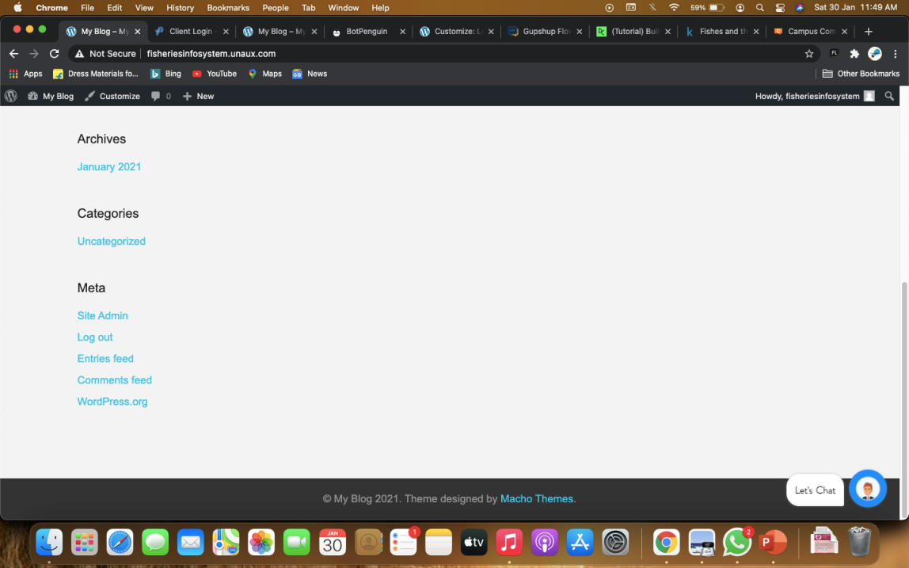
Basic Outlook of our model:

Slide 9
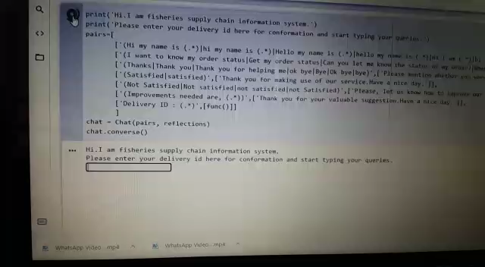
Demo video of the chatbot

Slide 10
References:
https://www.datacamp.com/community/tutorials/building-a-chatbot-using-chatterbot
https://towardsdatascience.com/chatbots-are-cool-a-framework-using-python-part-1-overview-7c69af7a7439
https://wordpress.org/plugins/chatbot/#:~:text=You%20can%20also%20integrate%20this,with%20your%20Dialogflow%20V2%20agent
https://www.edureka.co/blog/how-to-make-a-chatbot-in-python/
https://www.chatcompose.com/connect-api-chatbot.html

Slide 11

Thank you

